Slide 1


OOP2 PROJECT SYSTEM
SMART
SCAN
RFID based ATTENDANCE System

Slide 2
SMART SCAN revolutionizes attendance tracking at Saint Cecilia's by utilizing RFID technology. This innovative system offers a streamlined approach to monitor the presence of students, teachers, and staff, ensuring precision and reliability. By automating the attendance process, SMART SCAN optimizes administrative tasks and promotes a more efficient educational environment.
About The System

Slide 3
Stake Holders
Registrar/Accounting (Super Admin)
Program Heads(Admin)
Teachers(User)

Slide 4
Registrar/Accounting
(SuperADMIN)

Slide 5
They Can Add A Staff/Students
Responsible For Activation of Account
Responsible For Activation of Student
They Can Add/Delete Grade Levels And Section
Registrar
/Accounting

Slide 6
Program Heads
(ADMIN)

Slide 7
They Can Olny Add and Delete Students
Also They Can Add an Account For a User/Co ADMIN but they Need An Activation from Super ADMIN
They Cant Retrieve Students
Program Heads

Slide 8
Teachers
(USERS)

Slide 9
They Can Olny View The Attendnce Record When the Student Asked For it
Teachers

Slide 10
Hardware Needed

Slide 11

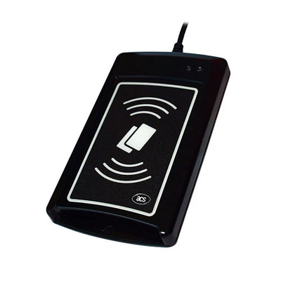


Hardware for The System
System Unit
RFID Scanner
Big Monitor/TV
RFID Cards

